Slide 1
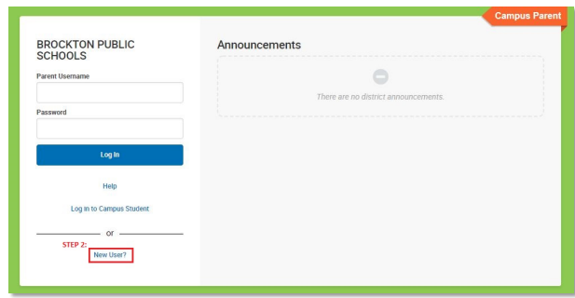
Creating an IC Portal Account
Open the following link: Campus Parent (bpsma.org)
Click on New User

Slide 2
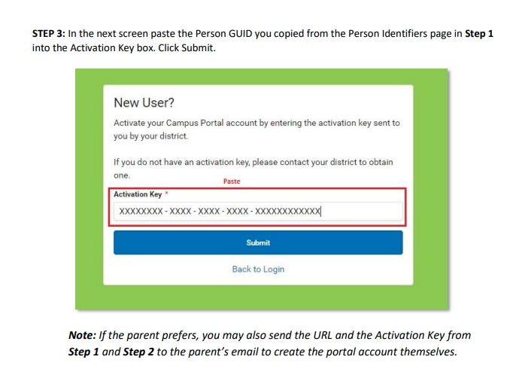
Contact your student's guidance office for your unique Activation Key number
Enter your activation key (you can copy and paste if the number is sent to you in email)
Click Submit

Slide 3
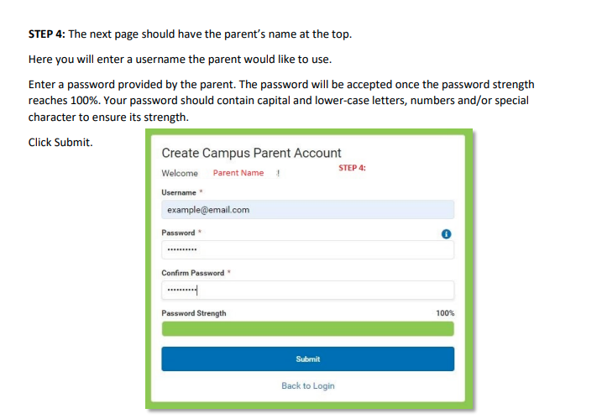
You should see your name at the top of the page.
Enter a Username
Enter a password. The password will be accepted once the password strength reaches 100%. Your password should contain capital and lower-case letters, numbers and/or special character to ensure strength.
Click submit

Slide 4
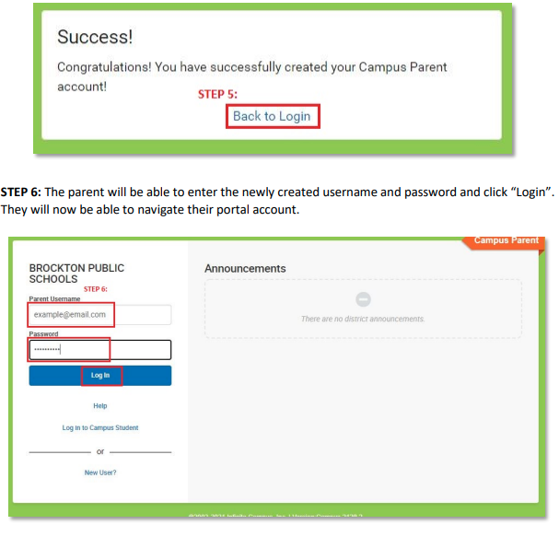
Success! You Have created a Parent Portal Account.
Click “Back to Login”
Enter your newly created username and password.
Click “Login”
You will now be able to navigate your portal account.

